Slide 1
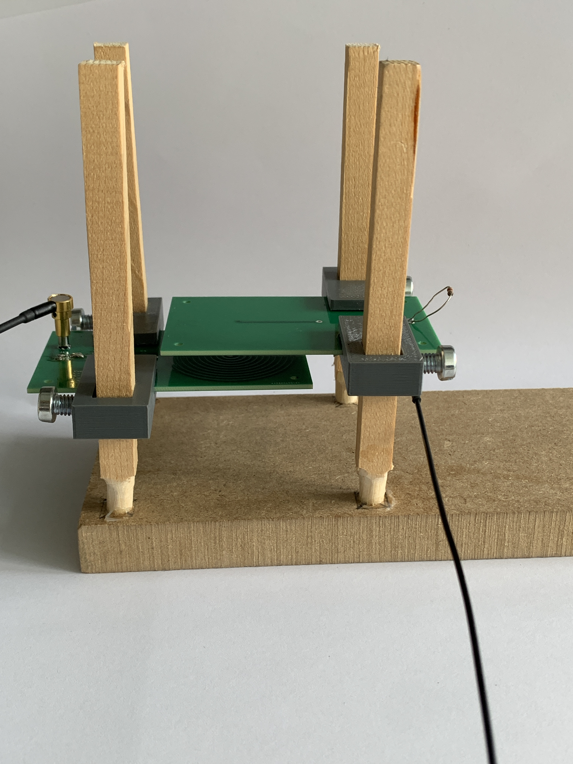
Simulation and implementation of a Wireless Power Module for dielectric elastomer actuator
By Tomas Garate Anderegg
Supervised by Maribel Caceres

Slide 2
Table of Contents
Objectives
State of the Art
Approach Taken
Key Challenges & Constraints
First Results
Hardware testing
Fine tuning
Results
Improvements
Conclusion

Slide 3
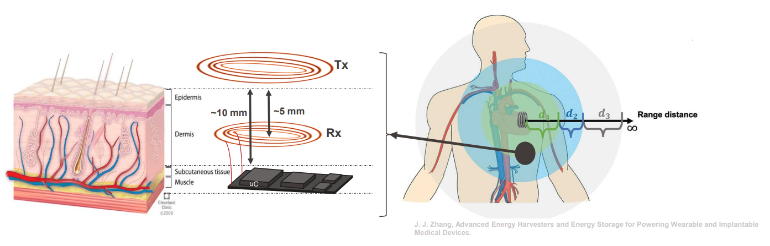
Objectives

Slide 4
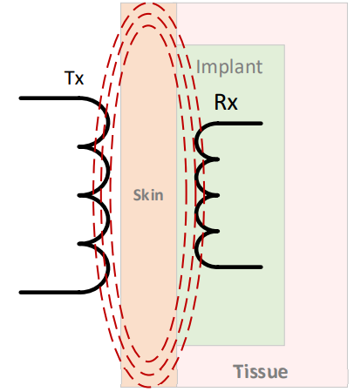
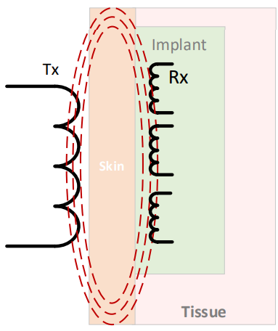
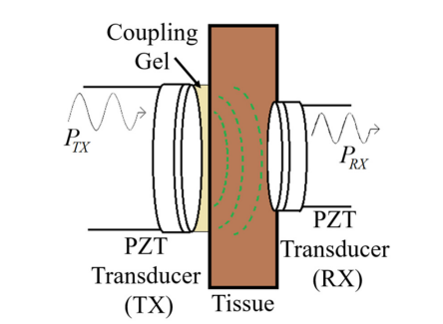
State of the Art
Good candidates for WPT techniques | Pros | Cons
Inductive Coupling | -Power transfert efficiency depends on quality factor, good matching impedance and optimal load impedance -100 kHz – 10 MHz for safety and good PTE | -Sensitive to misalignment -Misalignment can reduce the PTE -3D coils structure can improved the misalignment problem but complexe solution
Multiple Inductive Coupling | -Different type of coil architecture can lead to good PTE -Can have better performance than NRIC | -Higher complexity than NRIC -Effect of misalignment is worse on the PTE compared to NRIC -Higher operating frequency than NRIC leading to potential biosafety problems
Acoustic | -Good PTE -Good frequency range for biosafety | -Under-studied effect on the body -Difficult to design -PTE sensitive to the distance between TX and RX

Slide 5
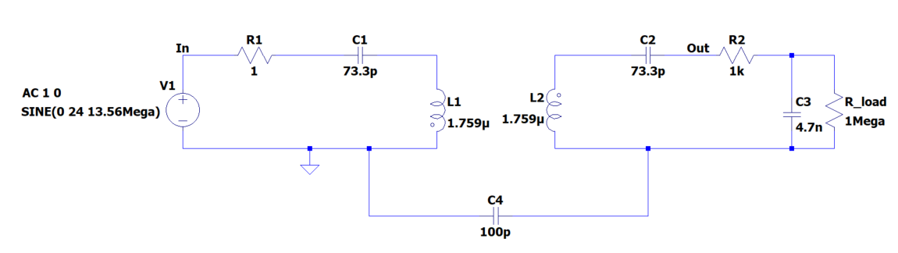
Approach Taken
Inductive coupling firstly
Matching Impedance
Load
M₁₂

Slide 6
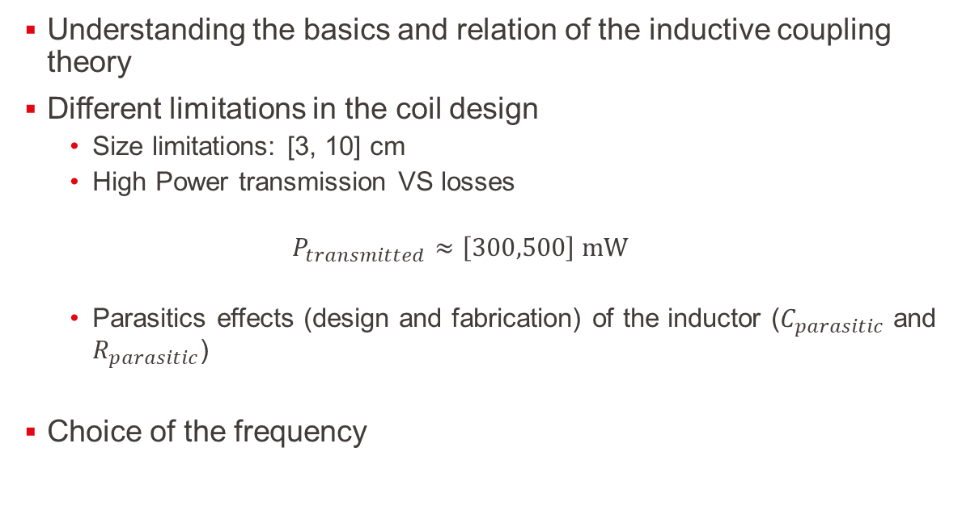
Key Challenges & Constraints
Understanding the basics and relation of the inductive coupling theory
Different limitations in the coil design
Size limitations: [3, 10] cm
High Power transmission VS losses
$$P_{transmitted}≈\left[300,500\right] mW$$
Parasitics effects (design and fabrication) of the inductor ($C_{parasitic}$ and $R_{parasitic}$)
Choice of the frequency

Slide 7
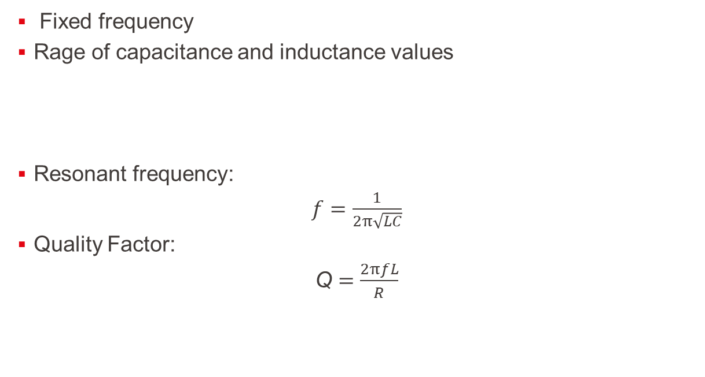
Key Challenges & Constraints: Choice of the frequency - finding the components
Fixed frequency
Rage of capacitance and inductance values
Resonant frequency:
$f$ $=\frac{1}{2π\sqrt{LC}}$
Quality Factor:
Q $=\frac{2πfL}{R}$
Capacitance | Inductance
~[10 pF; 1 nF] | ~[5, 100] µF

Slide 8
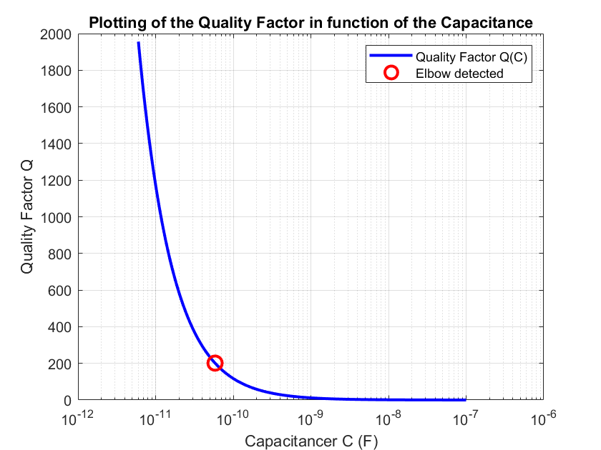
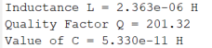
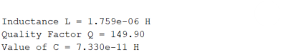
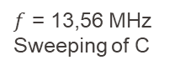
Key Challenges & Constraints: Choice of the frequency - finding the components
Matlab
Quality Factor
+
Resonant frequency
$f$ = 13,56 MHz
Sweeping of C
Adjusted value of C

Slide 9
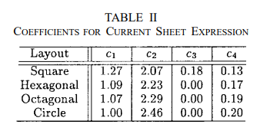
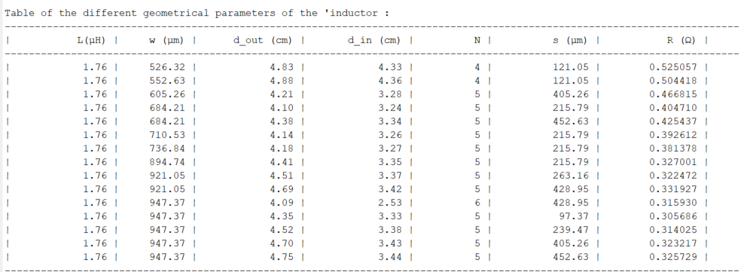
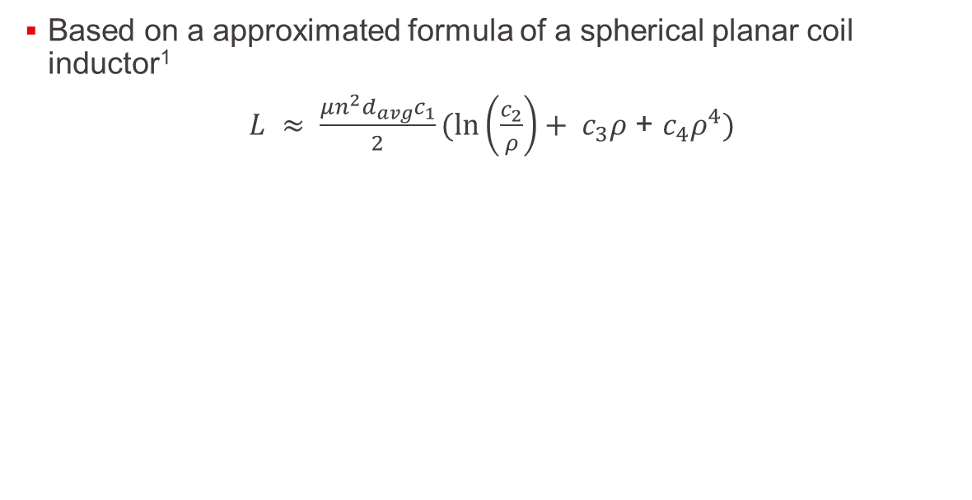
Key Challenges & Constraints: Choice of the frequency - finding the components – finding the geometric values of L
Based on a approximated formula of a spherical planar coil inductor¹
$L ≈ \frac{μn^{2}d_{avg}c_{1}}{2}(\ln\left(\frac{c_{2}}{ρ}\right)+ c_{3}ρ$ + $c_{4}ρ^{4})$
1. Mohan, S. S., Hershenson, M. del M., Boyd, S. P., & Lee, T. H. (1999). Simple Accurate Expressions for Planar Spiral Inductances. IEEE Journal of Solid-State Circuits, 34(10), 1419-1424.

Slide 10
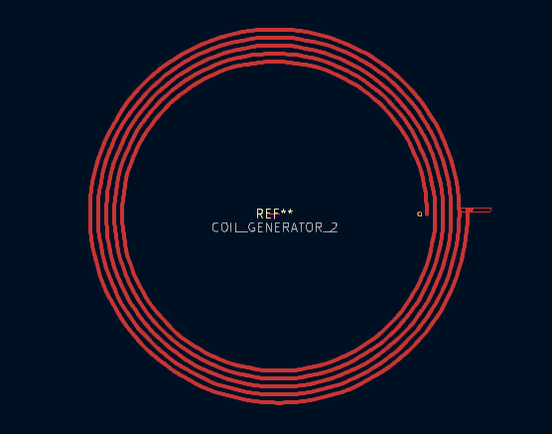
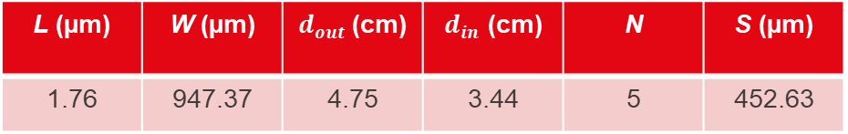
First Results: Coil design
Rx
Tx
L (µm) | W (µm) | $d_{out}$(cm) | $d_{in}$ (cm) | N | S (µm)
1.76 | 947.37 | 4.75 | 3.44 | 5 | 452.63

Slide 11
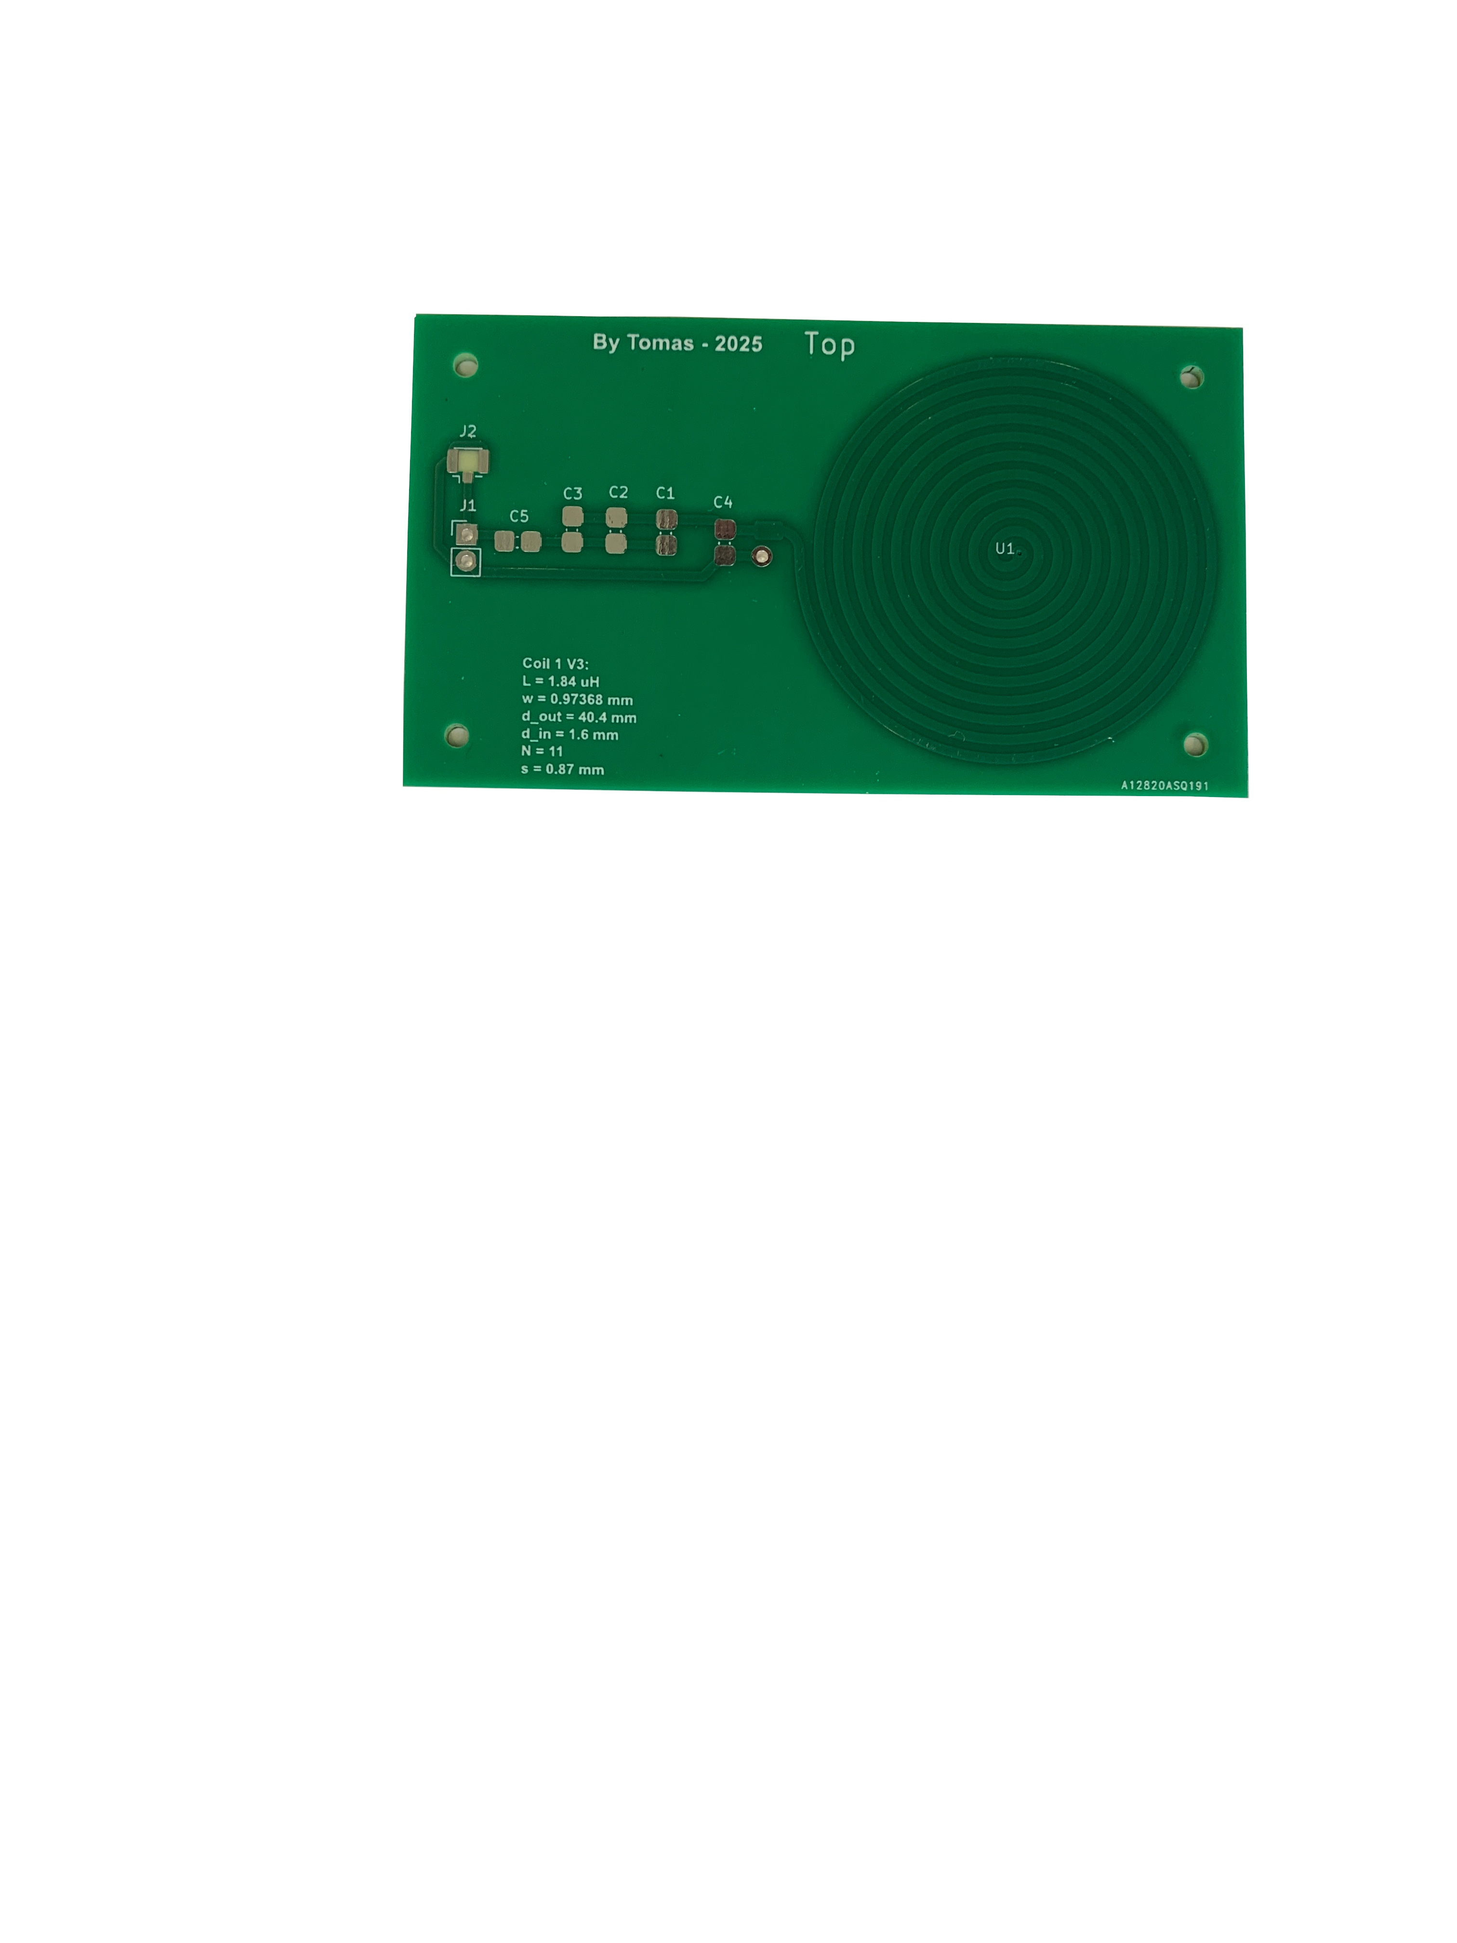
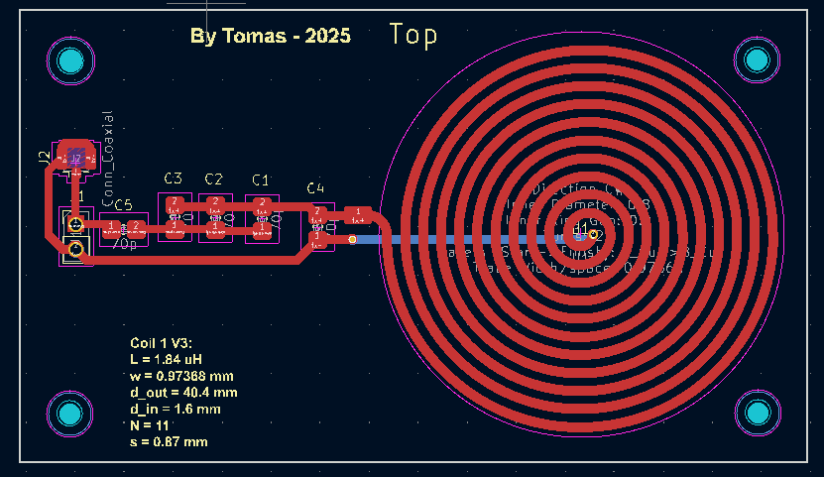
Hardware testing: From CAD to PCB

Slide 12
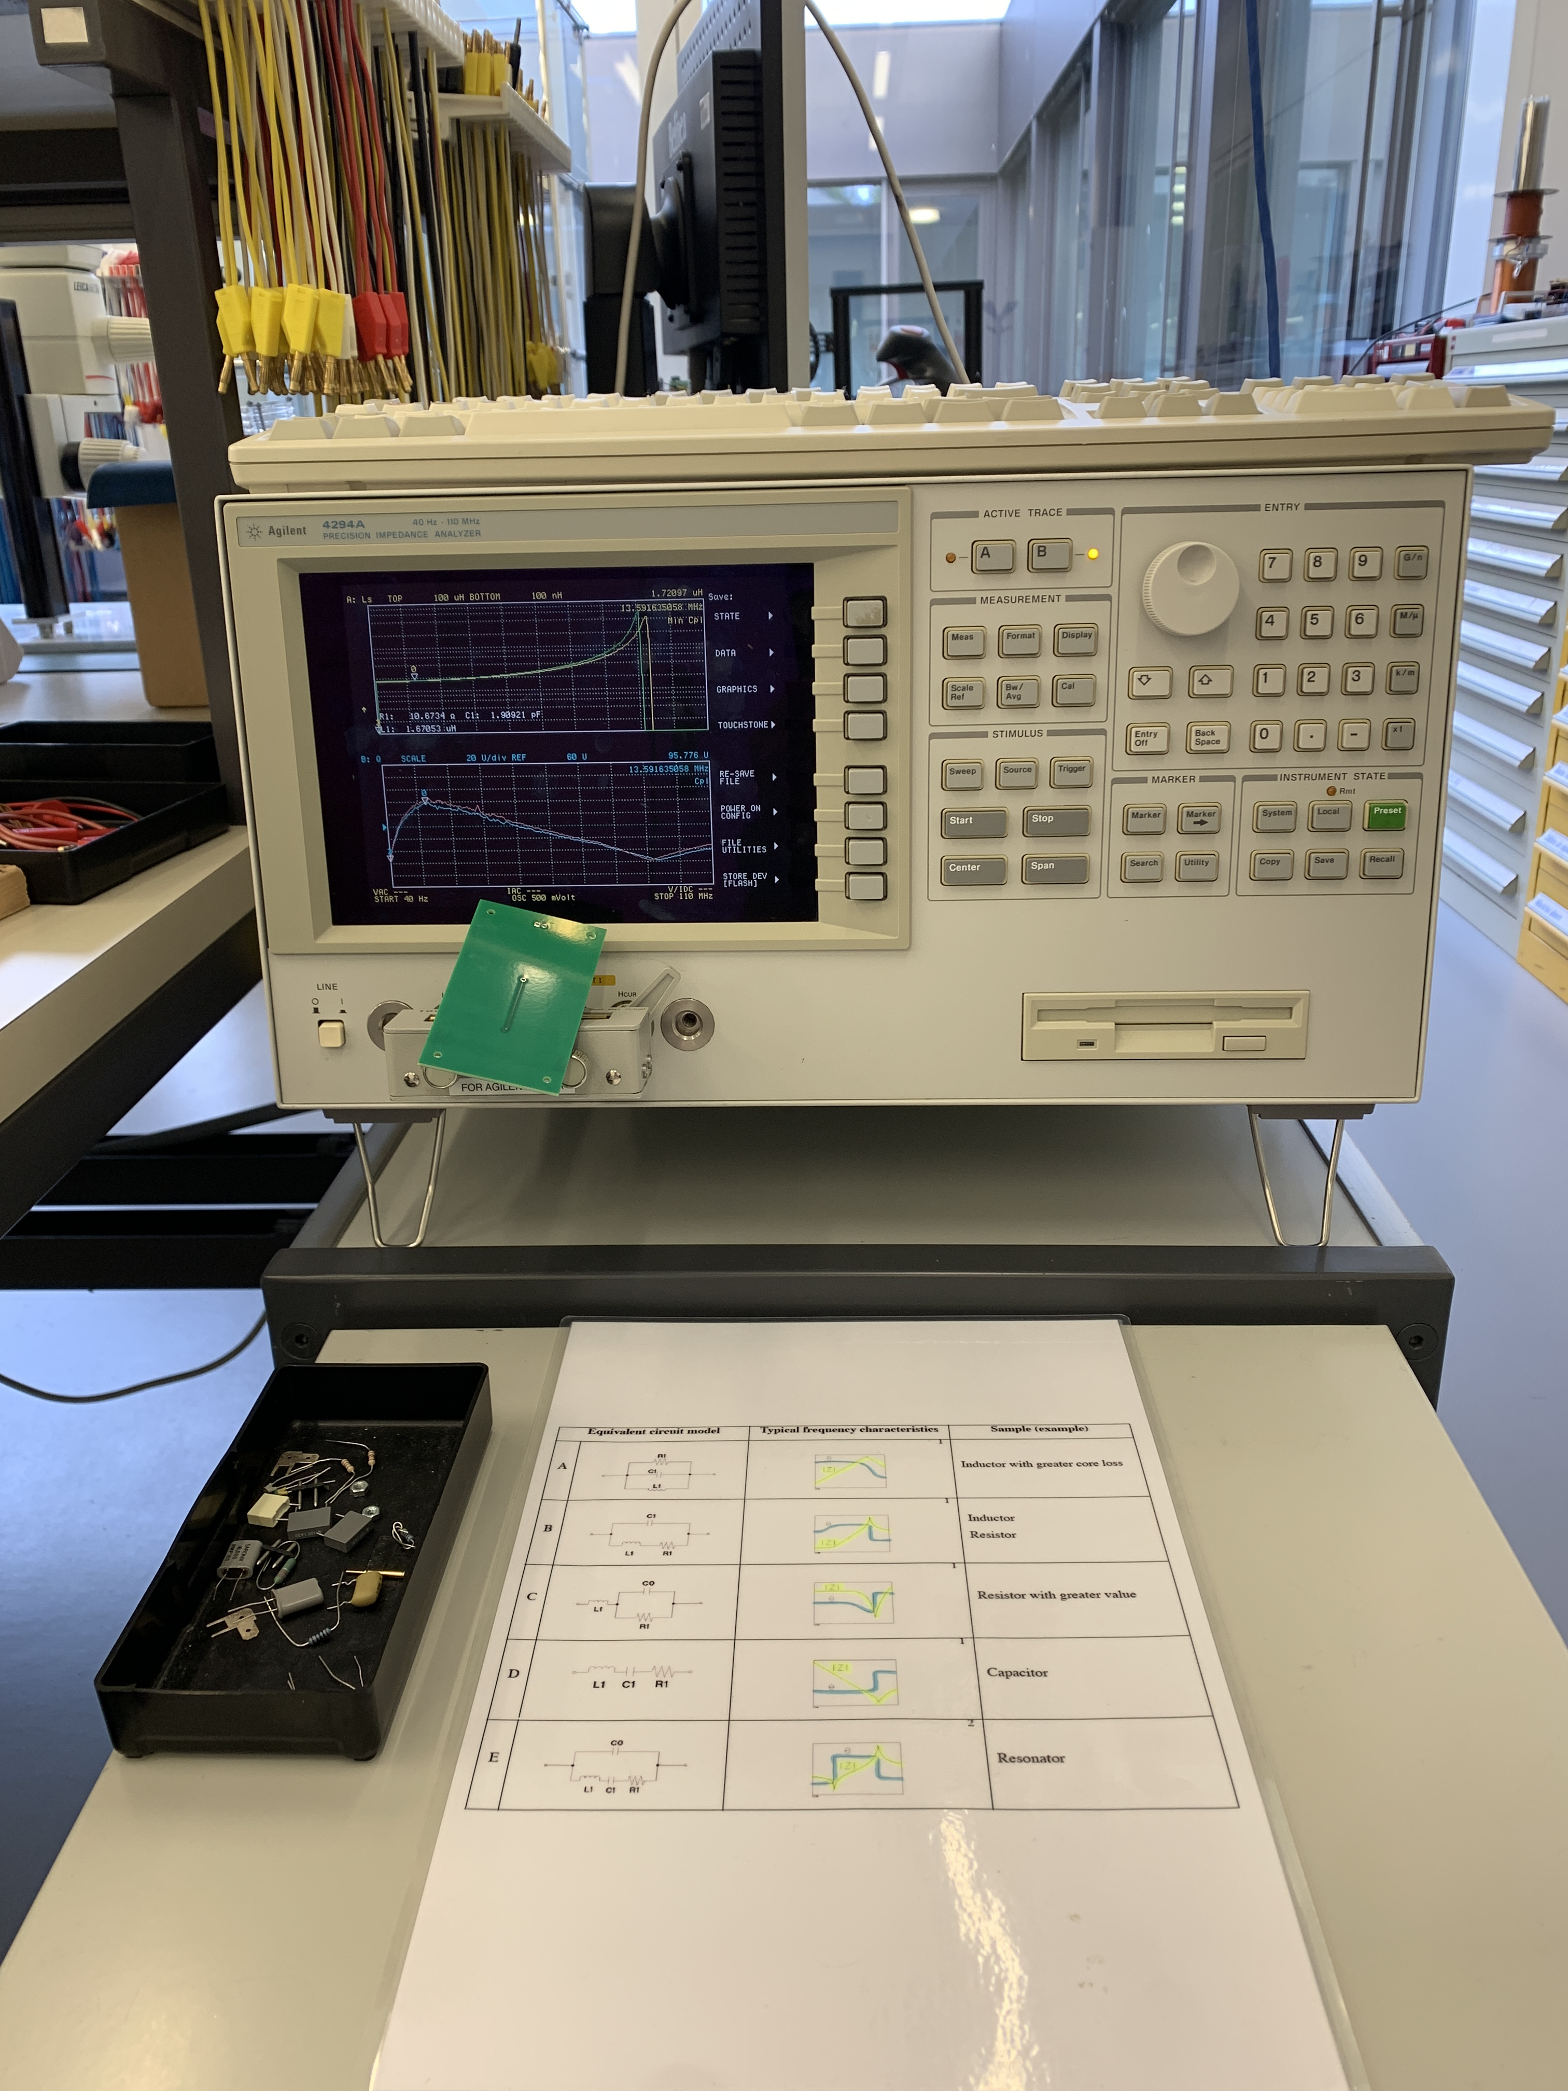
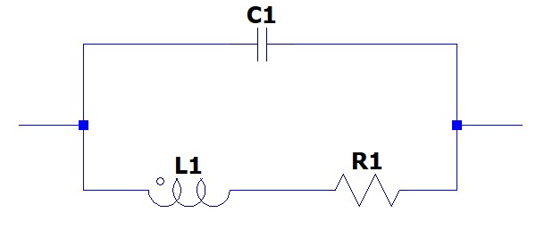
Hardware testing: From Theory to Reality: Coil
Agilent 4294A Precision Impedance Analyzer, 40 Hz – 110 Hz
Model used: (Inductor/ Resistor)

Slide 13
Hardware testing: From Theory to Reality: Coil
Theoretical value of L = 1.83 μH
R1 [Ω] | C1 [pF] | L1 [μH]
10.67 | 1.90 | 1.67

Slide 14
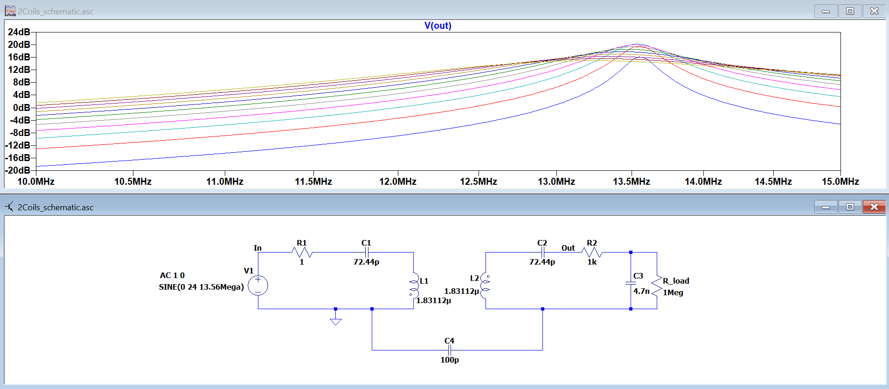
Fine tune: Adjusting components based on actual measured values: Theory

Slide 15
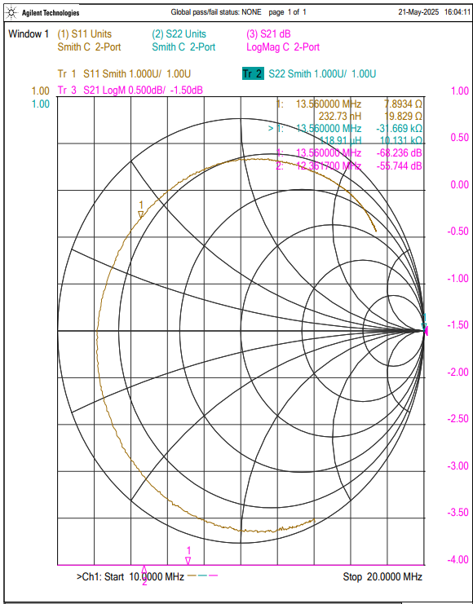
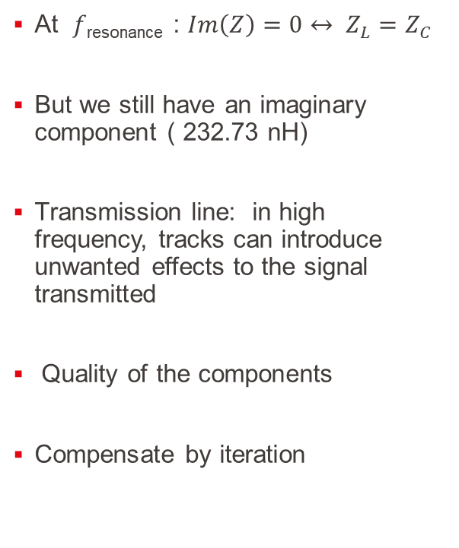
Fine tune: Adjusting components based on actual measured values: Reality
At $f$_{resonance} : $Im\left(Z\right)=0↔ Z_{L}=Z_{C}$
But we still have an imaginary component ( 232.73 nH)
Transmission line: in high frequency, tracks can introduce unwanted effects to the signal transmitted
Quality of the components
Compensate by iteration
Here
Goal

Slide 16
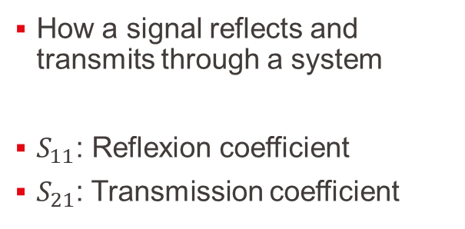


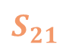
Results: What is $S_{11}$ and $S_{21}$ ?
How a signal reflects and transmits through a system
$S_{11}$: Reflexion coefficient
$S_{21}$: Transmission coefficient
$S_{11}$
Dipole System
$S_{21}$

Slide 17
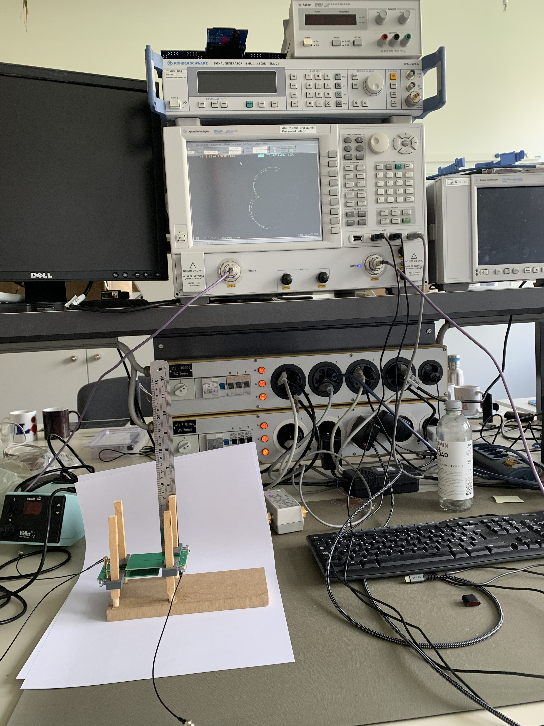
Results: Set up:
Agilent Technologies N5242A PNA-X Network Analyzer, 10 MHz-26,5GHz

Slide 18
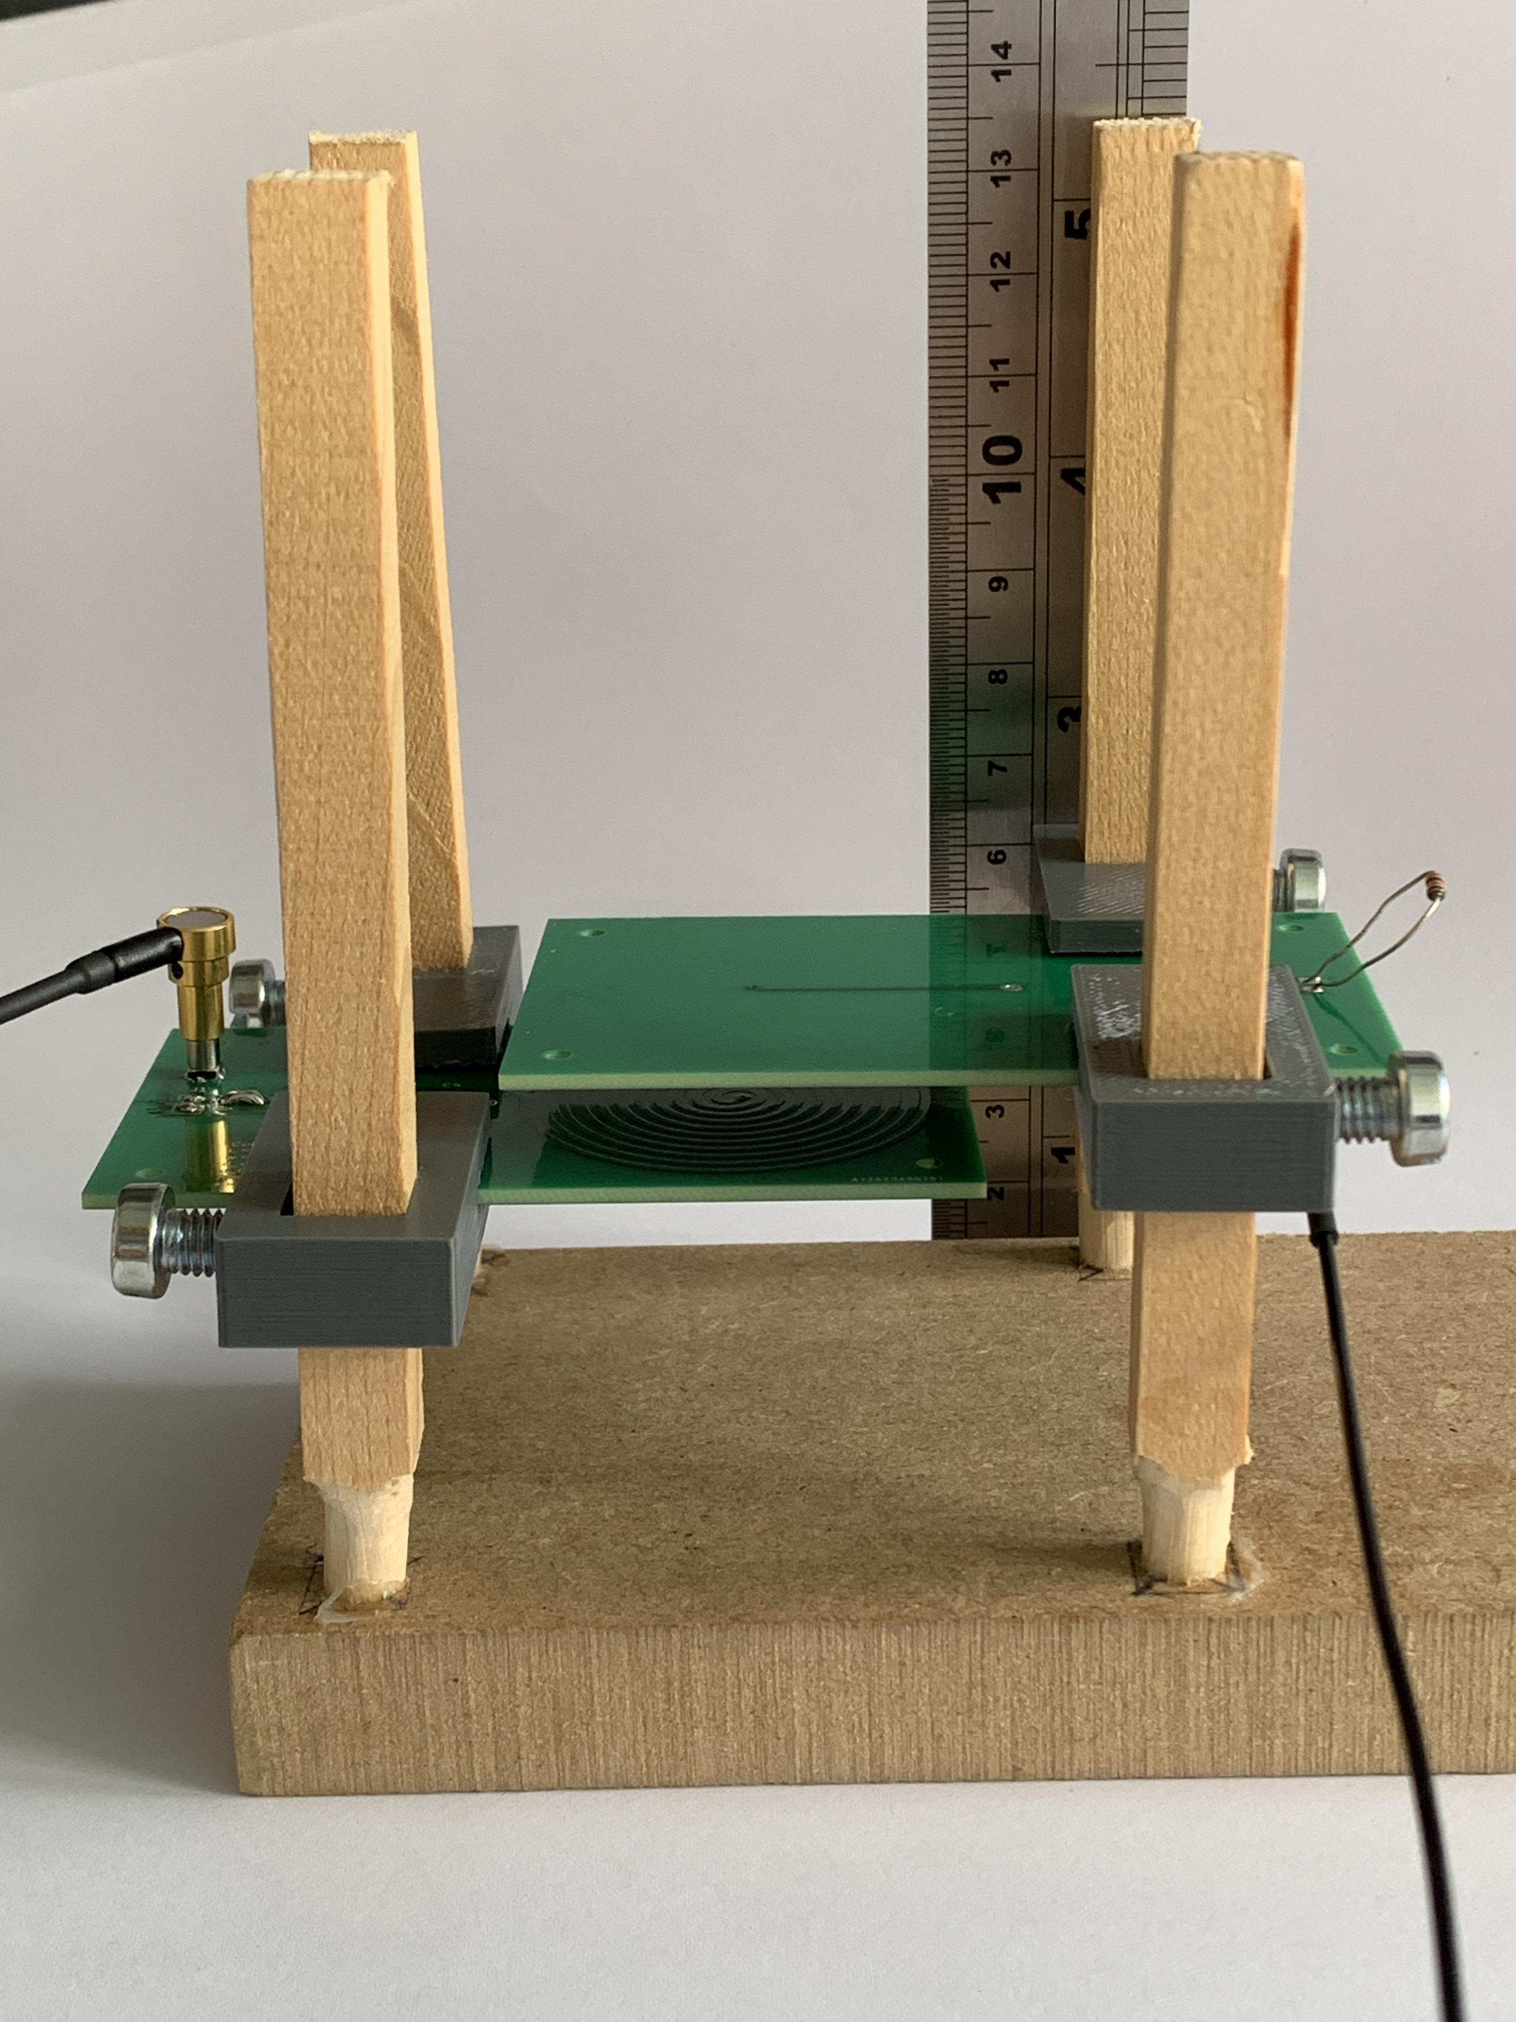
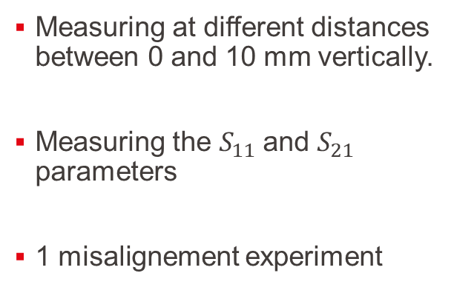
Results: Set up:
Measuring at different distances between 0 and 10 mm vertically.
Measuring the $S_{11}$and $S_{21}$ parameters
1 misalignement experiment
Load = 1 kΩ
Rx
Tx
10mm

Slide 19
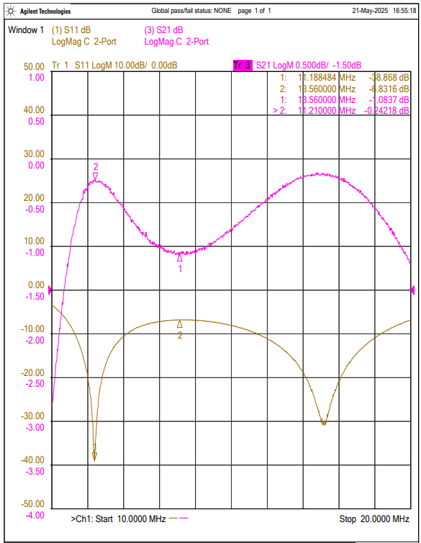
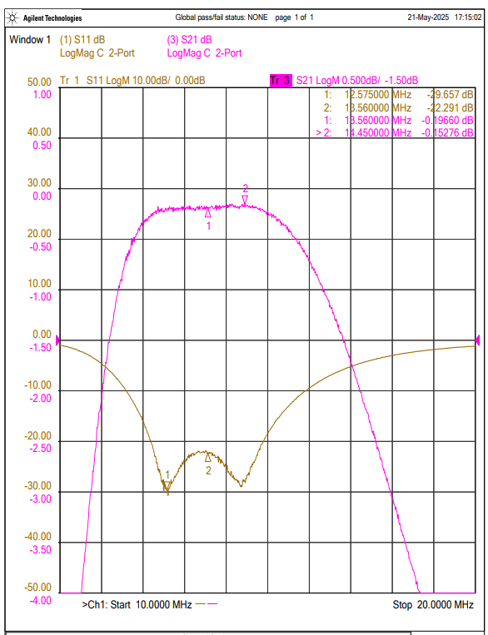
Results: Without load: Characterize the system with S-parameters
5 mm
10 mm

Slide 20
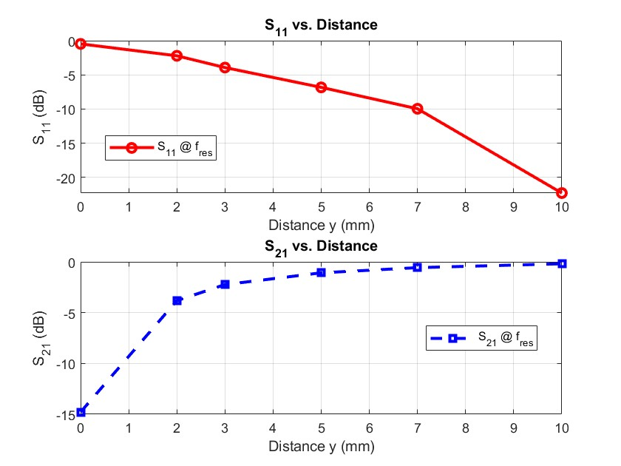
Results: Without load

Slide 21
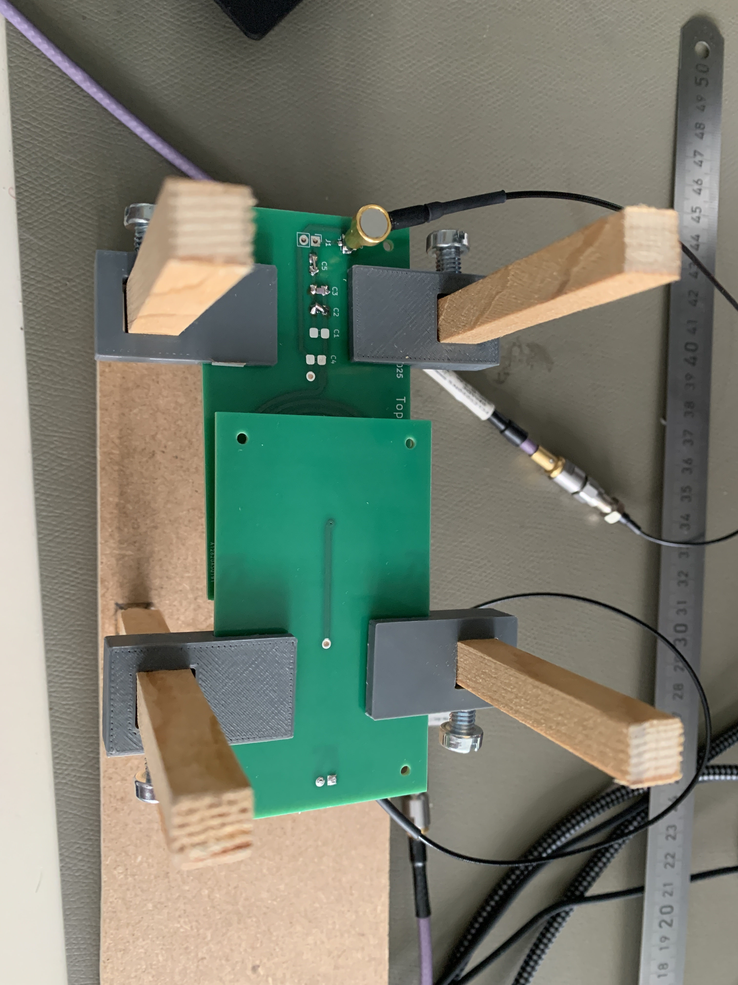
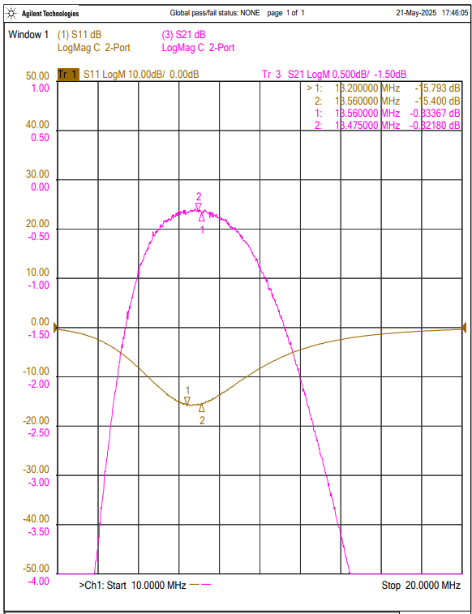
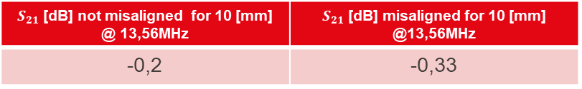
Results: Misalignment of 5mm
5 mm
$S_{21}$[dB] not misaligned for 10 [mm] @ 13,56MHz | $S_{21}$[dB] misaligned for 10 [mm] @13,56MHz
-0,2 | -0,33

Slide 22
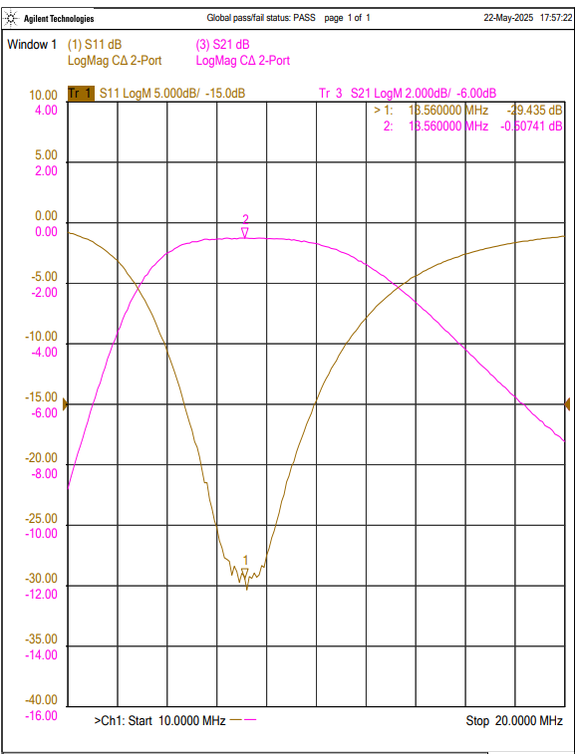
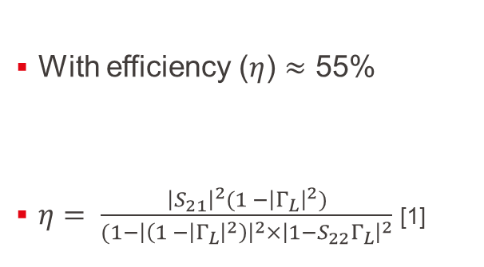
Results: With a load of 1kΩ at 10 mm
With efficiency ($η$) $≈$ 55%
$η= \frac{{\left|S_{21}\right|}^{2}(1 −{\left|Γ_{L}\right|}^{2})}{(1−{\left|\left(1 −{\left|Γ_{L}\right|}^{2}\right)\right|}^{2}×{\left|1−S_{22}Γ_{L}\right|}^{2}}$ [1]
[1]: M. Stanculescu, L. Iordache (Bobaru), M. Iordache, D. Niculae, and V. Bucata, "Using S Parameters in Wireless Power Transfer Analysis," in Proc. 10th Int. Symp. Adv. Topics in Electr. Eng. (ATEE), Bucharest, Romania, Mar. 2017, pp. 107–110, doi: 10.1109/ATEE.2017.7905129

Slide 23
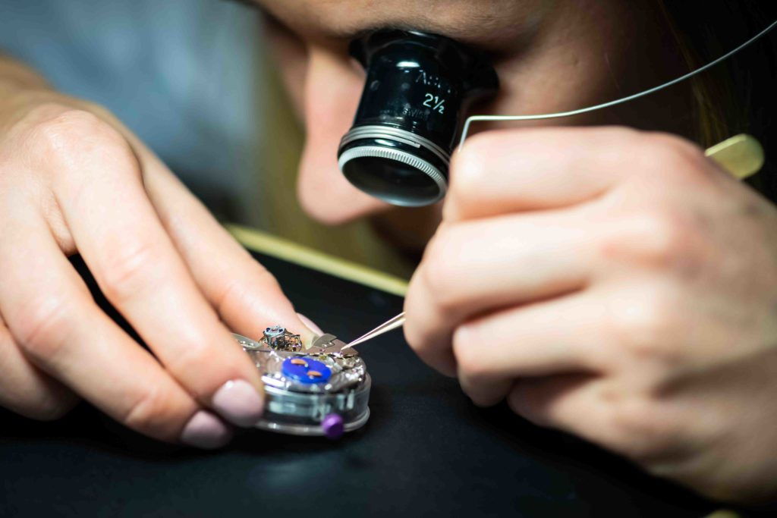
Improvements:
Iterative fine-tune
Good quality components
Transmission line
https://mediamsuisse.ch/horlogerie-suisse/

Slide 24
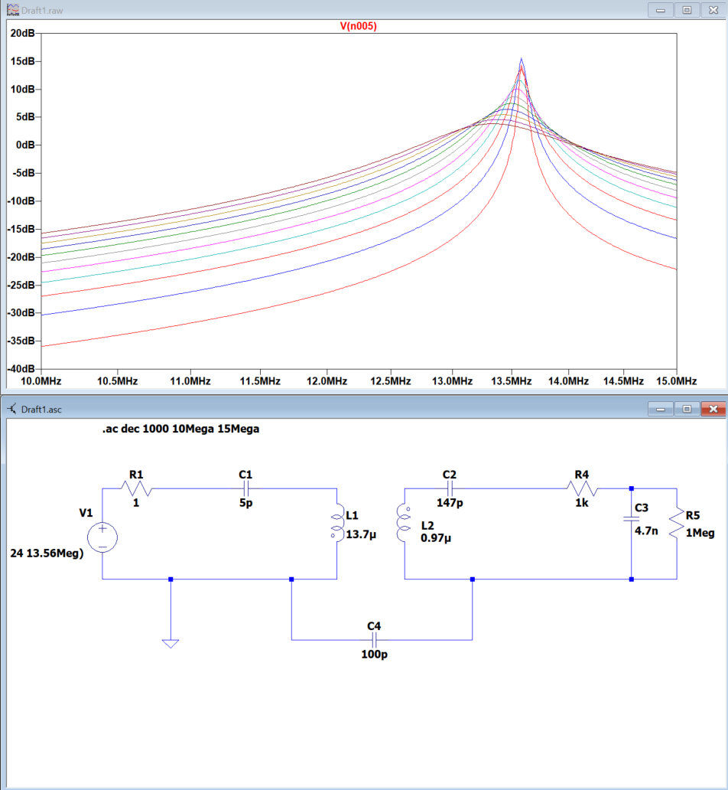
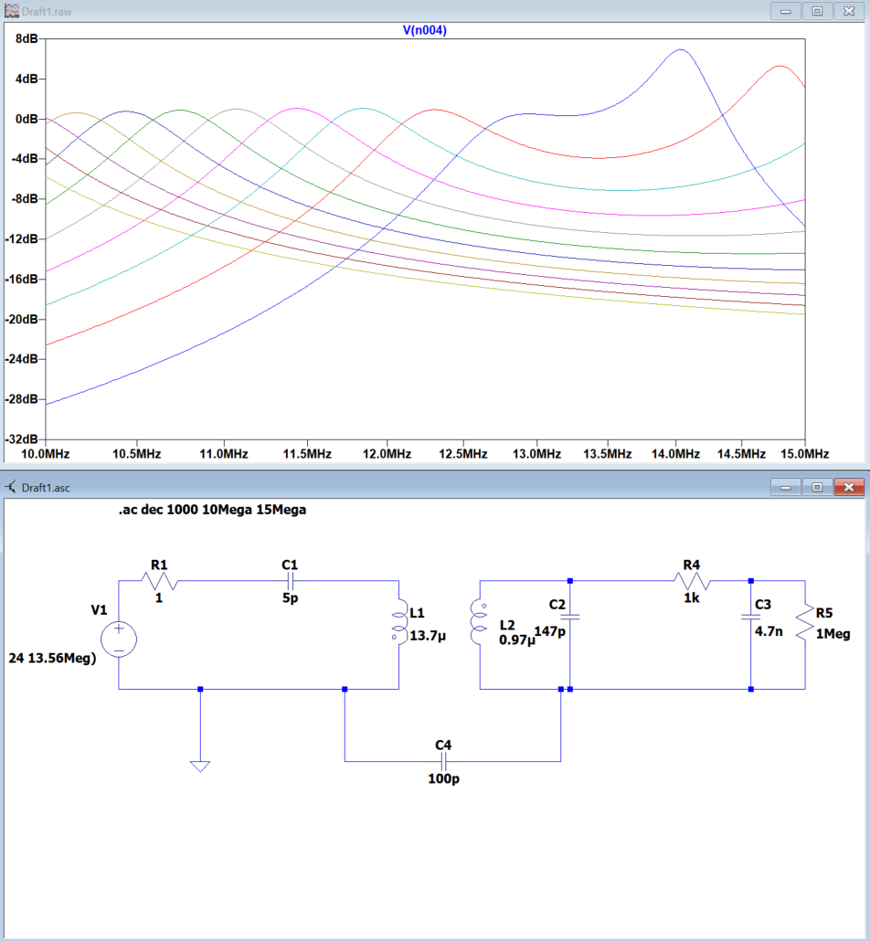
Improvements – to explore more: Simulation on Matlab for asymmetrical coils
SS
SP

Slide 25
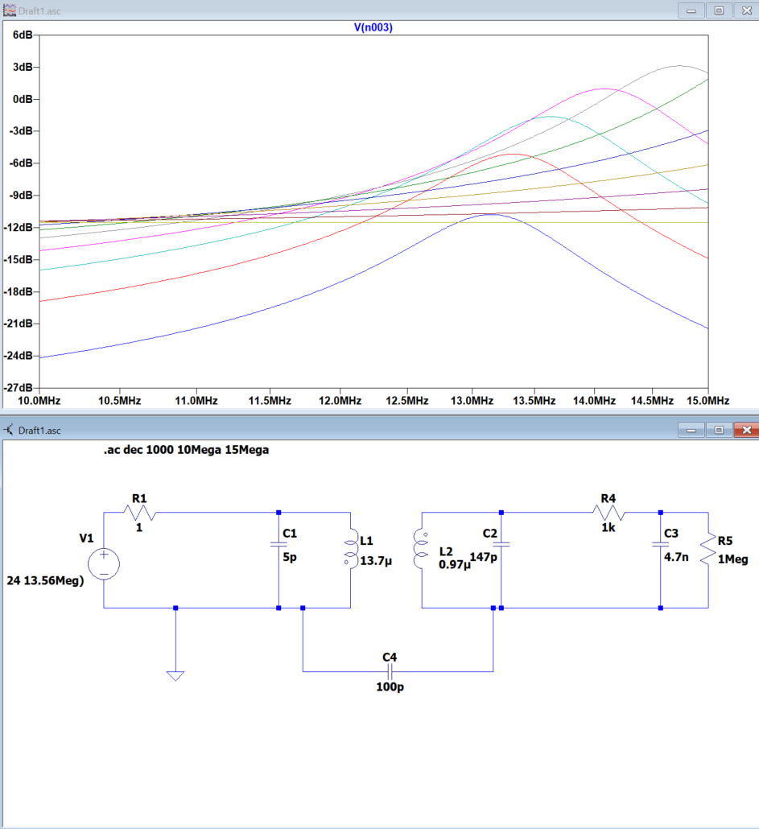
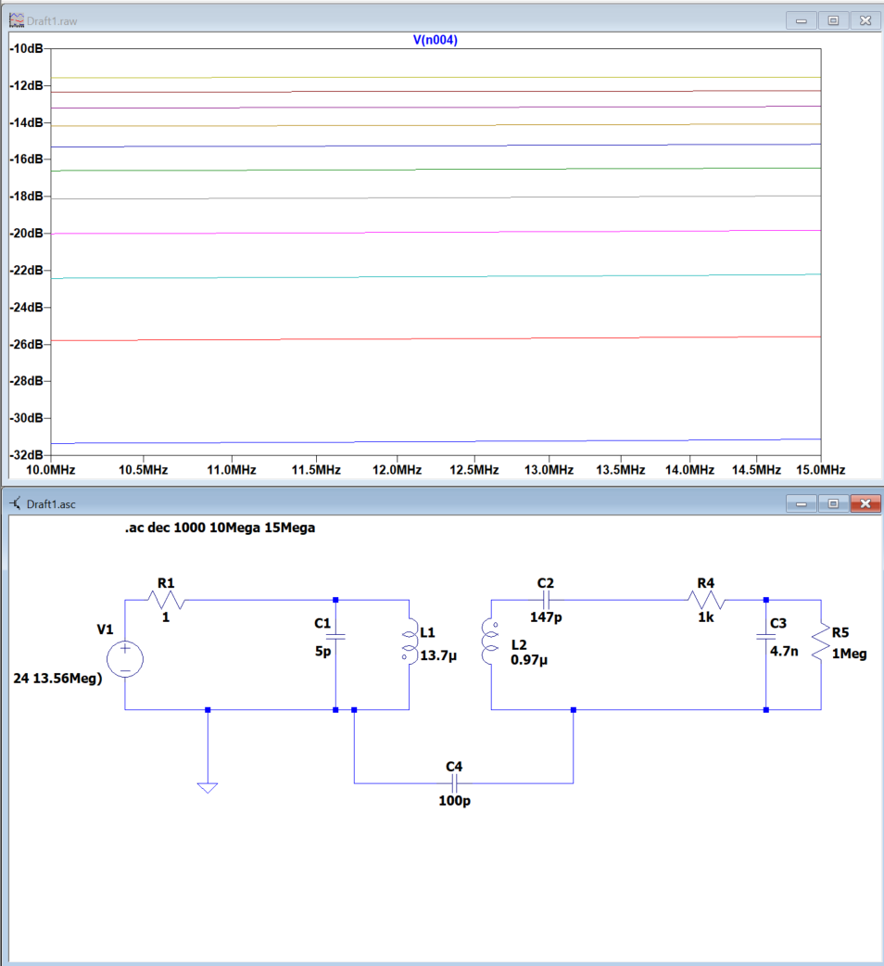
Improvements – to explore more: Simulation on Matlab for asymmetrical coils
PP
PS

Slide 26
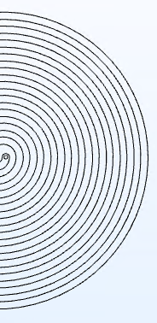
Conclusion
The design of such a device requires precision and careful consideration to achieve reliable and accurate results
Parasitics effects need to be highly considered in the fine-tuning steps
Frequency splitting observed in the SP topology as the value of K increases
From simulation/coding to hardware development and result analysis

Slide 27
References
[1]: M. Stanculescu, L. Iordache (Bobaru), M. Iordache, D. Niculae, and V. Bucata, "Using S Parameters in Wireless Power Transfer Analysis," in Proc. 10th Int. Symp. Adv. Topics in Electr. Eng. (ATEE), Bucharest, Romania, Mar. 2017, pp. 107–110, doi: 10.1109/ATEE.2017.7905129
[2]: https://mediamsuisse.ch/horlogerie-suisse/
[3]:La science quantique: Une vision singulière, cours 3 p.3.7 2024, par Pierre-André Besse
[4]: F. Caspers, RF engineering basic concepts: S-parameters, CERN, Geneva, Switzerland, [Online]. Available: https://cds.cern.ch/record/1621520

Slide 28
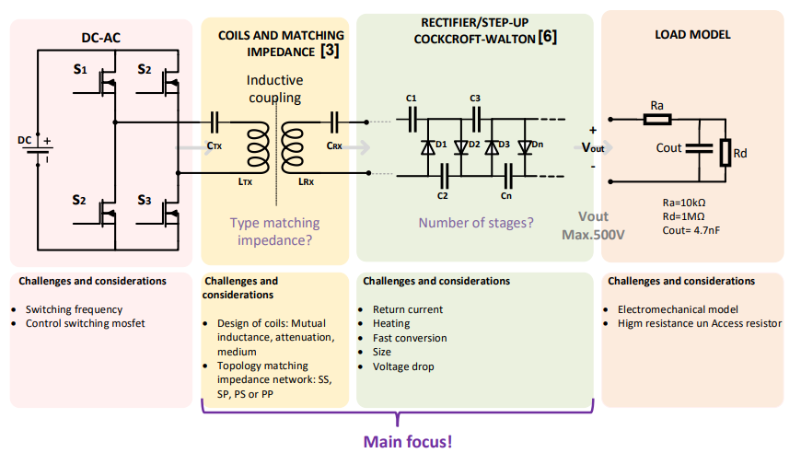

Slide 29
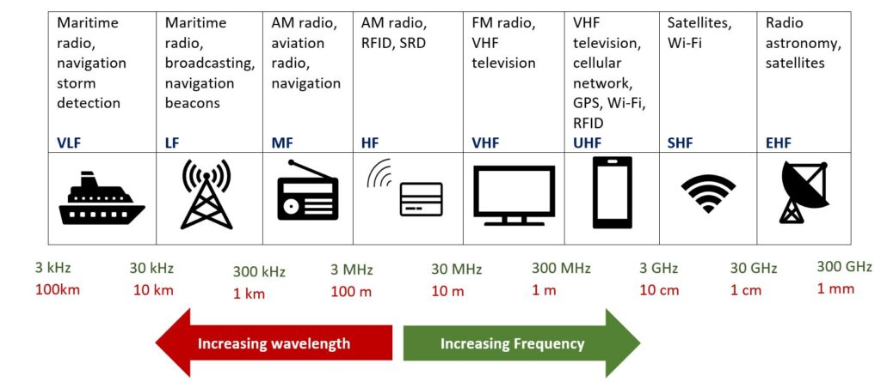
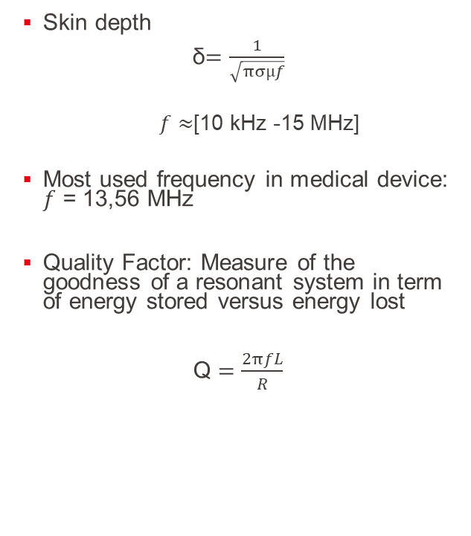
Key Challenges & Constraints: Choice of the frequency
Skin depth
δ$=\frac{1}{\sqrt{πσµf}}$
$f$ $≈$[10 kHz -15 MHz]
Most used frequency in medical device: $f$ = 13,56 MHz
Quality Factor: Measure of the goodness of a resonant system in term of energy stored versus energy lost
Q $=\frac{2πfL}{R}$
https://soundgirls.org/a-beginners-guide-to-wireless-frequencies/

Slide 30
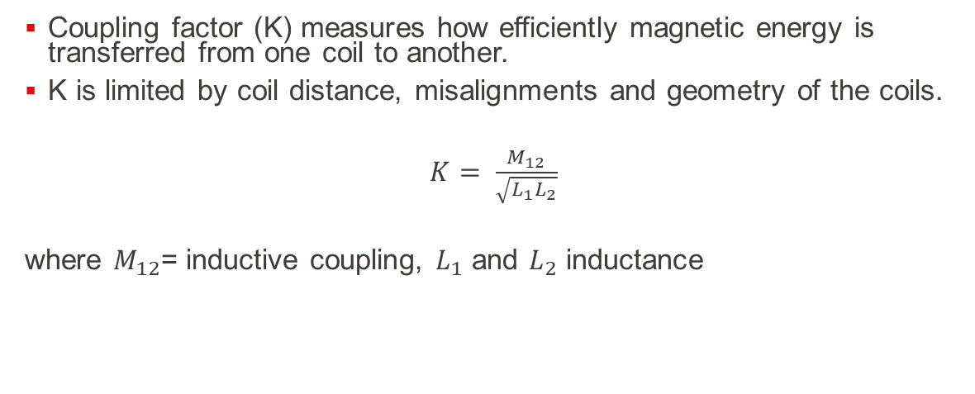
First Results:
Coupling factor (K) measures how efficiently magnetic energy is transferred from one coil to another.
K is limited by coil distance, misalignments and geometry of the coils.
$K= \frac{M_{12}}{\sqrt{L_{1}L_{2}}}$
where $M_{12}$= inductive coupling, $L_{1}$ and $L_{2}$ inductance

Slide 31
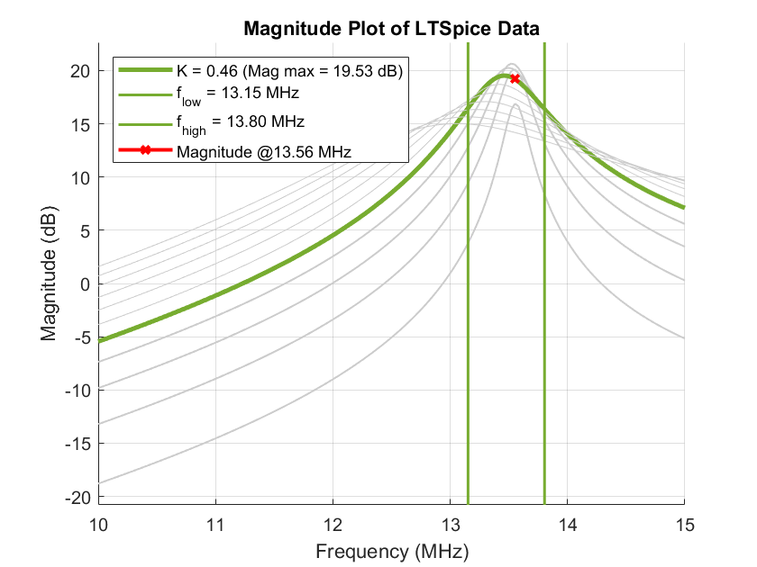
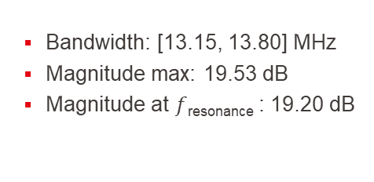
First Results: Simulation of the circuit with different values of K
Bandwidth: [13.15, 13.80] MHz
Magnitude max: 19.53 dB
Magnitude at $f$_{resonance} : 19.20 dB

Slide 32
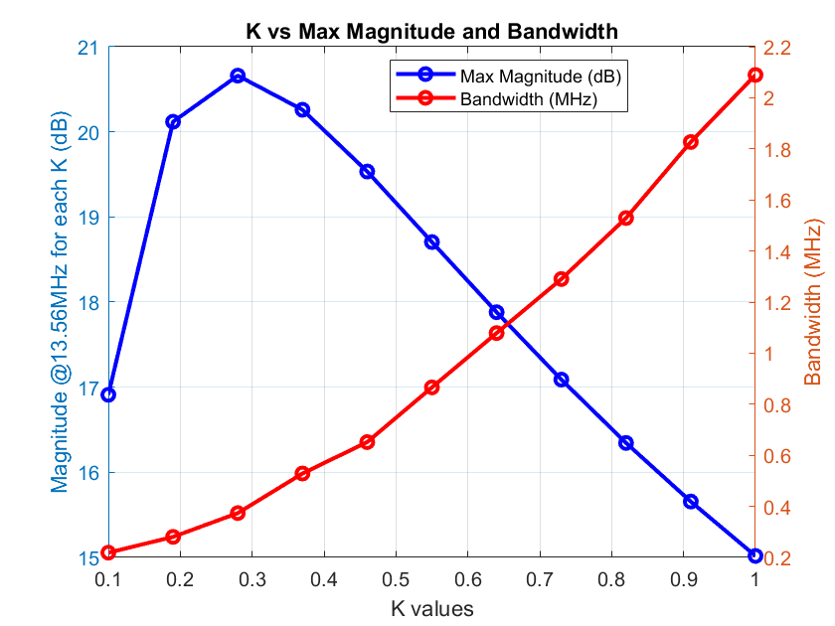
First Results: Simulation of the circuit with different values of K
Trade-off: Bandwidth versus coupling factor (K)
High K → large bandwidth + small maximal amplitude of the transmitted signal
Small K →small bandwidth + bigger maximal amplitude of the transmitted signal

Slide 33


First Results: Simulation of the circuit with different values of K – Efficiency
Also considering the efficiency of the system
$η= \frac{P_{out}}{P_{in}}=$ $\frac{V_{out}I_{out}}{V_{in}I_{in}}$
With values of $I_{out}$in the mA magnitude

Slide 34


Slide 35


Slide 36


Hardware testing: From Theory to Reality: Coil
R1 [Ω] | C1 [pF] | L1 [μH]
10.67 | 1.90 | 1.67
$R\left(f\right)=R_{DC}+R_{skin}(f$) + $R_{proximity}(f$) + …
For skin effect the higher $f$ the more the current goes on the border of the wire. The resistance increases
The closer two tracks are, the higher the resistive losses due to prox. effect

